Slide 1

MIS 547
Cloud Computing

Slide 2
Admin
Assignment 2 Due Sunday at Midnight
Quiz 2 Due Sunday at Midnight
Group formations- September 10
Late policy
20% deduction

Slide 3
Updates from Slack
Tanya’s poll in #general
Azure AZ-900/ AWS Cloud Practitioner
Skye’s post in #general about Cloud Native + Kubernetes AI Day
Academic pricing
LF discounts on hotels and airfare
Funding from UArizona?

Slide 4
AGENDA
Agenda
Containers
Docker

Slide 5
Lecture 4: Containers

Slide 6



Recall from Last Lecture
VM Image
OS
Apps
Config
Data
Virtual Machines
Hypervisors allow us to run more than one guest OS on a host
VMs are logically isolated from one another and share the underlying host’s resources
Images
VM images contain the OS, applications, config files, data to generate an exact replica of any VM
VM
VM
Guest
HV
Host

Slide 7
Virtual Machines
High availability
VMs make it much more straightforward to have multiple copies of our server running in parallel
We can resize virtual machines as needed!
One exception: can’t reduce disk size once it’s been allocated; only increase

Slide 8
Virtual Machines: Scaling Out vs Scaling UP
Scale up (vertical scaling)
Scale out (horizontal scaling)

Slide 9


Virtual Machines
CLI (or API or console)
Image
VM
SSH

Slide 10
Virtual Machines: Assignment 2
doctl compute droplet create \
-- ssh-keys <SSH Key ID>
--image ubuntu-24-04-x64 \
--size s-1vcpu-1gb \
--region sfo3 \
droplet name
CLI
VM
SSH
sudo apt update
sudo apt upgrade
sudo apt install software-properties-common –y
sudo apt install –y make build-essentials
curl https://pyenv.run |bash
…

Slide 11

Virtual Machines
Specialized images will do a lot of the configuration and installations for you!
CLI
VM
SSH
sudo apt update
sudo apt upgrade
sudo apt install software-properties-common –y
sudo apt install –y make build-essentials
curl https://pyenv.run |bash
…

Slide 12
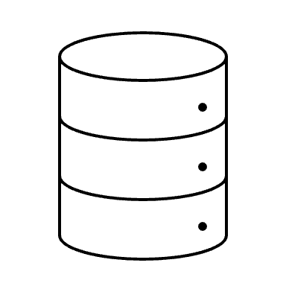

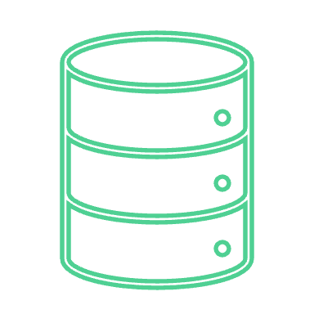
Virtual Machines, cont.
Server 1
Server 1
Maintenance can still be a challenge
Production server + small update to application
Have to rebuild an entire OS image + application to redeploy
Time consuming to build and regenerate
Configuration drift
Image
Server 2
Server 2
ad hoc change
Server 3
Server 3

Slide 13
Virtual Machines, cont.
Inefficiencies
Storage
Compute
Memory
VM Images can be large because VMs encompass the entire operating system
Kali Linux ISO: 4GB
Ubuntu ISO: 3.4GB
Windows ISO: 4.45GB
Windows Server: 31.GB

Slide 14


Virtual Machines, Cont.
3 redundant VMs for high availability
Hypervisor
CPU required for each VM
OS
Services
Processes
Applications
Storage for each VM
Ubuntu → 3.4 GB
Python 3.12 → 170MB
pyenv → 14MB
Jupyter server → 4GB
Notebooks (up to 25MB)
Network for each VM
Network interface (NIC)
IP address for each VM- can get expensive

Slide 15
VM Limitations
Boot time
Size
Scaling up requires a new VM; scaling out might not be fast enough
More overhead, use more resources → limits the # of VMs that can run on a single host machine.

Slide 16
Virtual Machines, Cont.
How can we improve on this?
Requirements
1. We want to be able to run many copies our application for high availability and resiliency
2. The copies need to be strictly standardized (no configuration drift)
3. We want the benefits of virtualization (specifically being able to run our application anywhere)
4. We want spin-up of our applications to be seamless and quick
5. We want to reduce the amount of compute, network, and storage we use…

Slide 17
Containers!

Slide 18
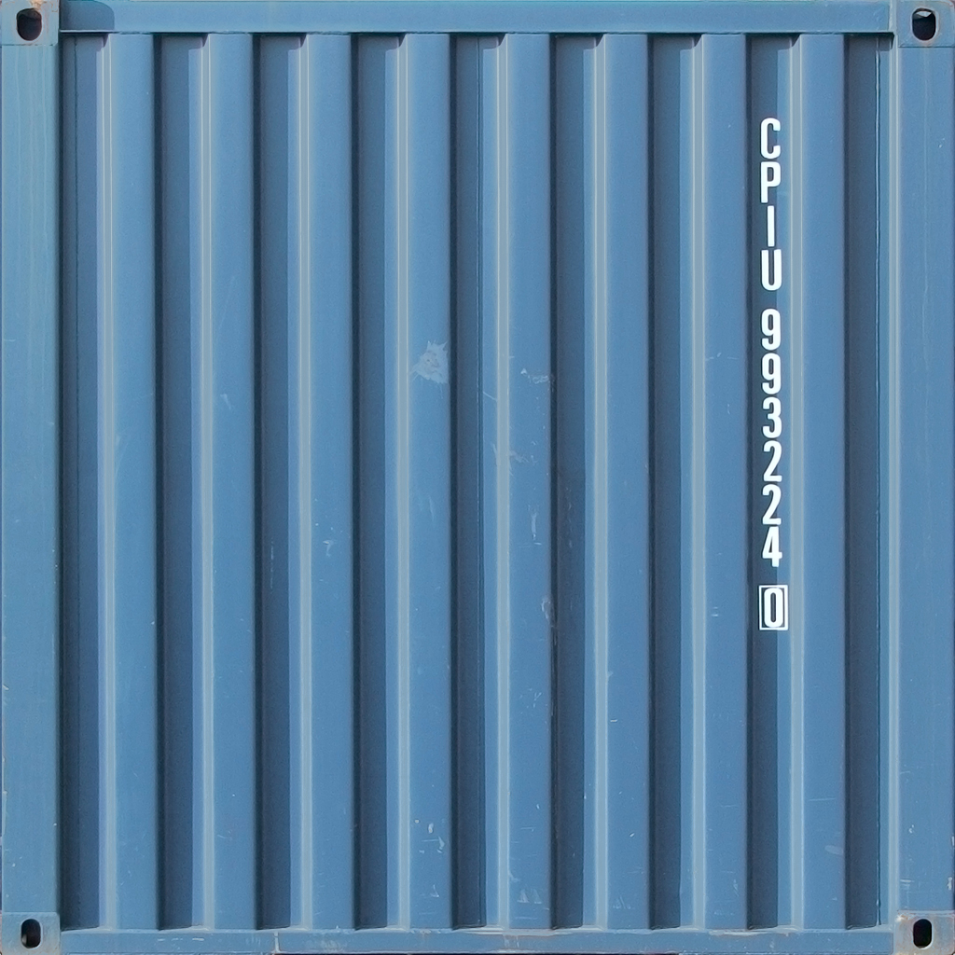
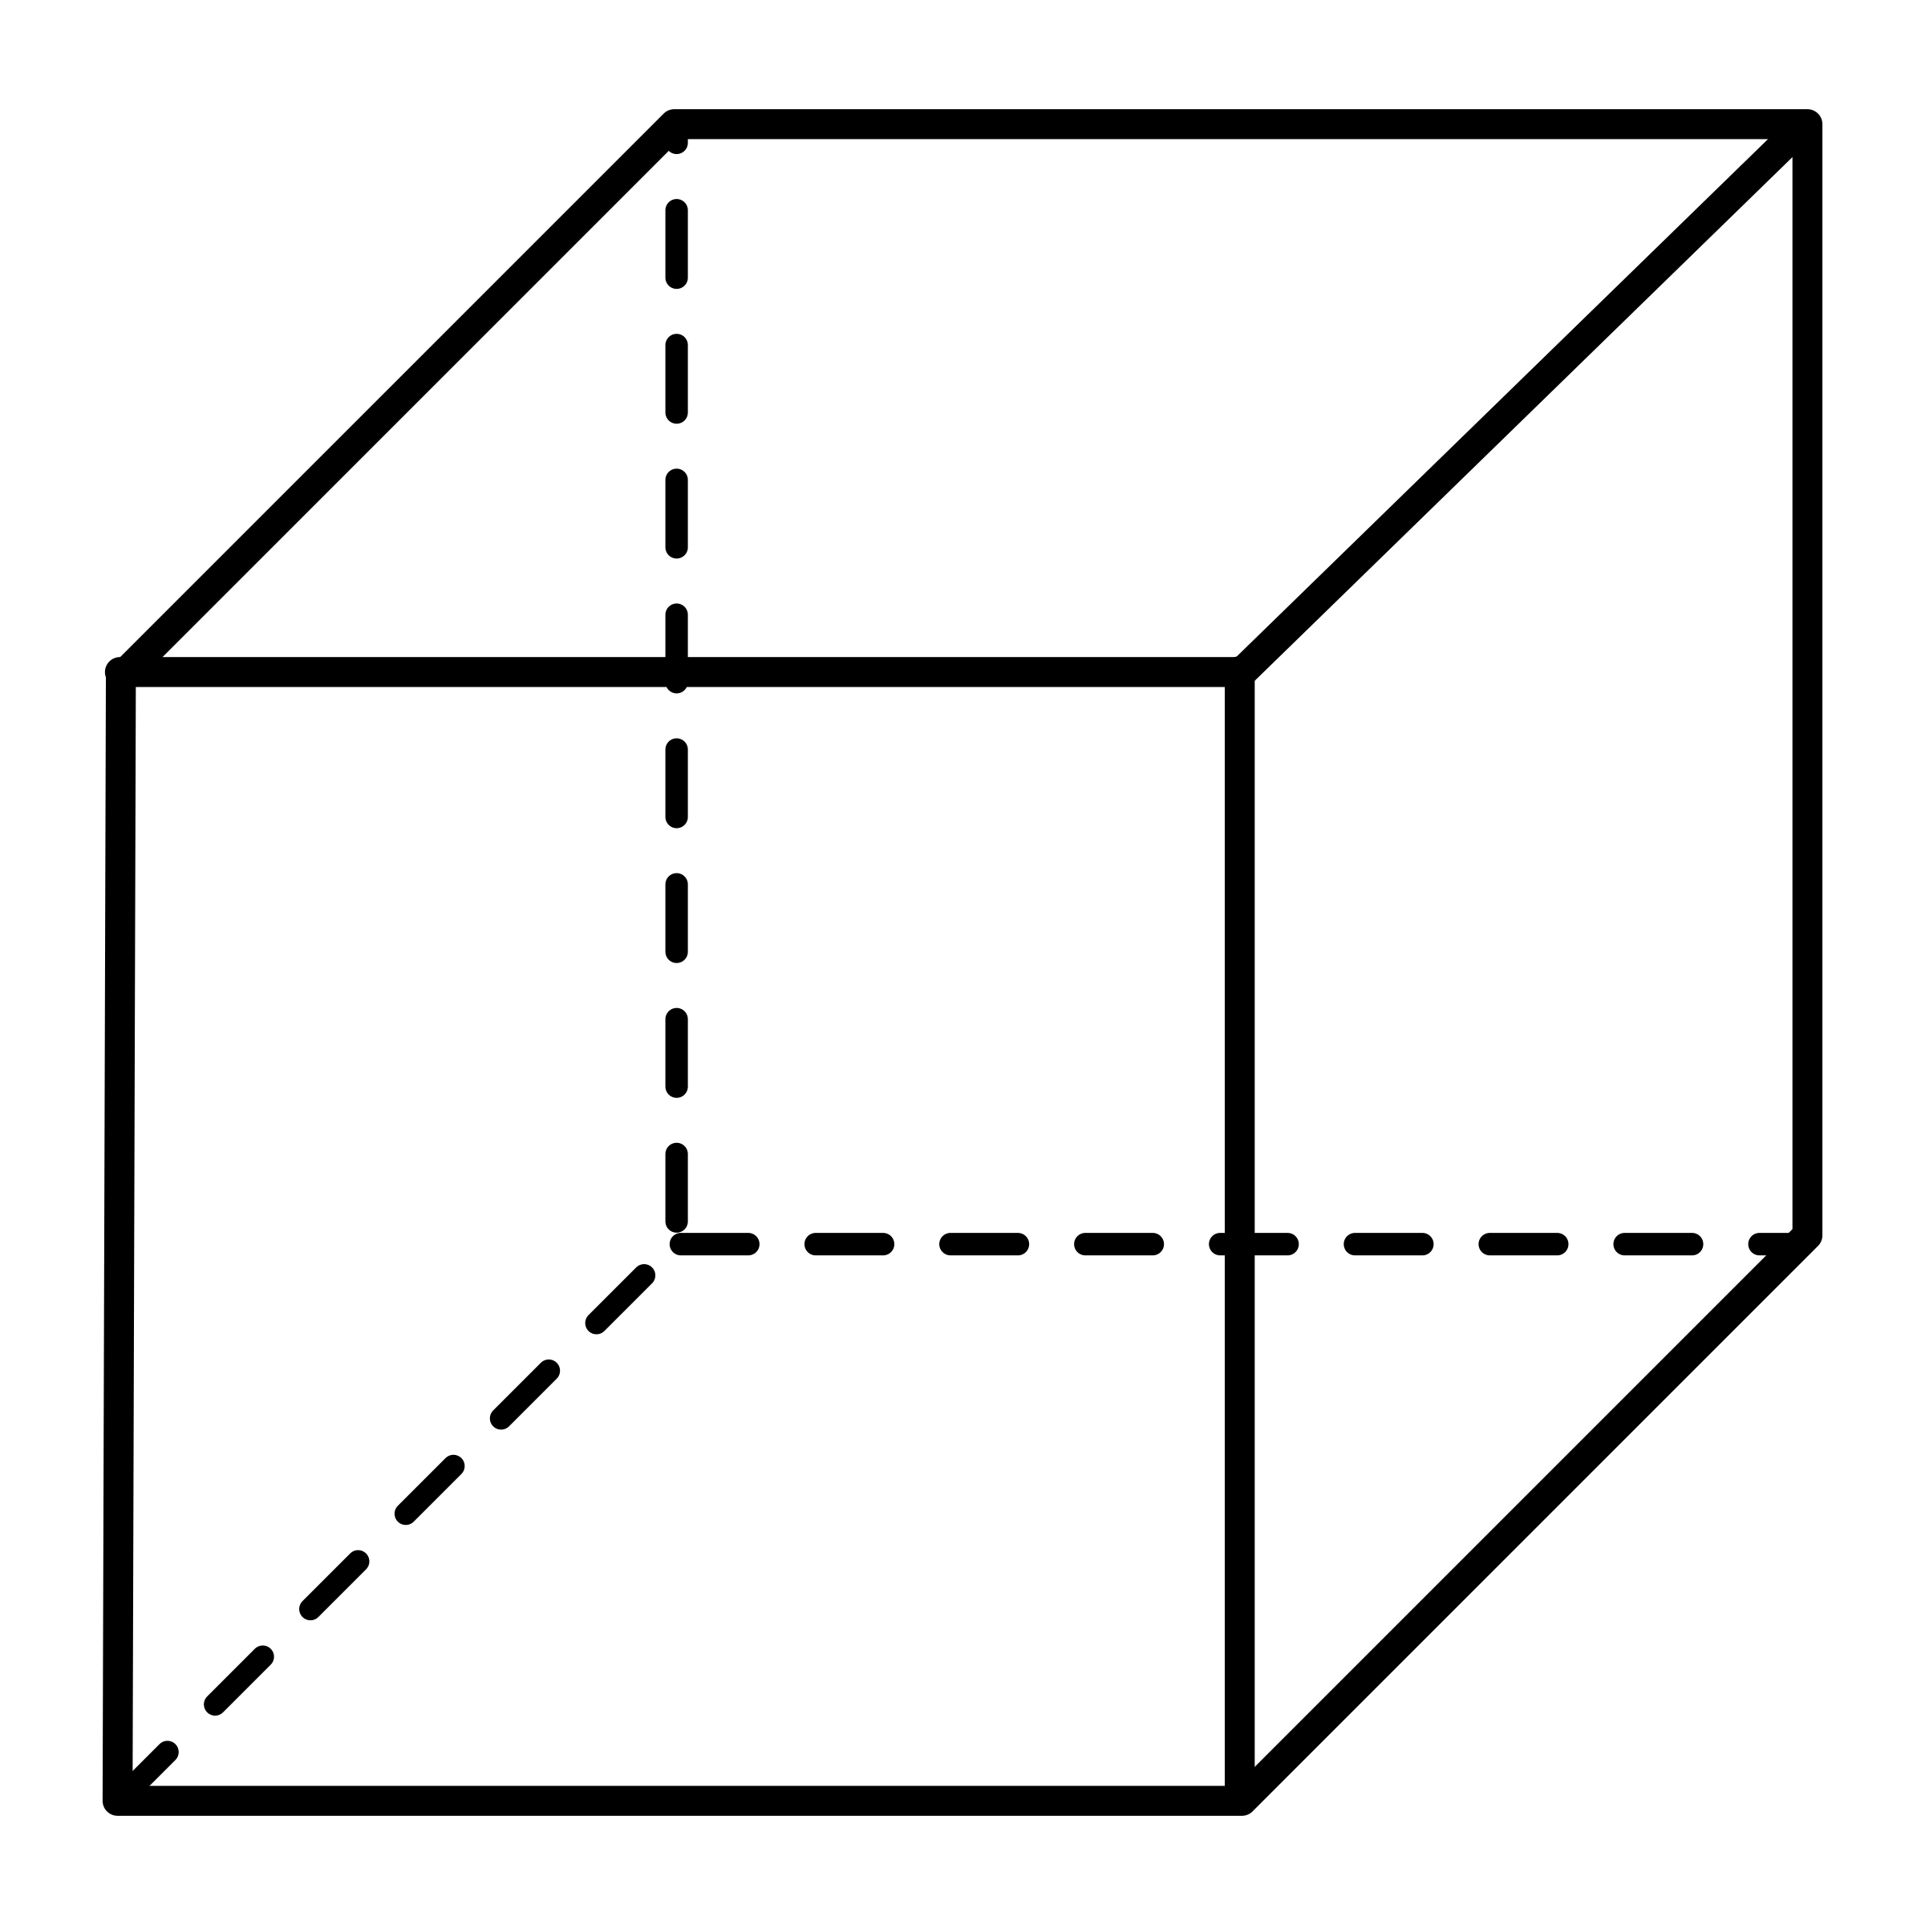
Containers
Containers are encapsulated, individually deployable components running as isolated instances on the same operating system with virtualization happening on the OS level.
A container is a sandboxed process running on a host machine that is isolated from all other processes running on that host machine.
Container A
Container B
Container C
Container Engine
Operating System

Slide 19

Containers
For modern applications, containers have become the default unit of deployment
They encapsulate the application code, its runtime, dependencies, system libraries,
Fast startup time → ideal for scale-out scenarios
app
runtime
dependencies
libraries

Slide 20
What are Containers?
Image
A container is a runnable instance of an image.
Can be run on local machine, virtual machines, deployed to the cloud.
Containers are portable and can run on any OS
Image needs to be built for a particular platform (e.g., x86, ARM)
Can be built for multi-platform using buildx, not sure if we’ll use it this semester
A container runs its own software, binaries, configurations, etc.

Slide 21
Why Do We need Containers?
Deterministic Deployment:
Application needs to work consistently on multiple platforms and different hardware
VM
Data center
Public and private clouds
Dev, test, prod

Slide 22

“It works on my machine”
This is not only a source of frustration, but a business process and product blocker.
Time spent troubleshooting
Critical migration timelines may be interrupted
Support by and from other developers is hindered

Slide 23
Containers: Runtime
Containerized apps believe they are running on their own dedicated computer and are oblivious that they are sharing resources with other processes
A container runtime is the software that executes containerized applications.
The runtime will start an app with a container and provide it with the needed resources.

Slide 24
Container Runtimes
Runtime is responsible for
Pulling container images
Interaction with the host operating system
Resource allocation and management
Running the container
Launches apps in a standardized fashion across all environments and sets security boundaries and resource limits.
Runtimes include containerd, CRI-O, runc.

Slide 25
Container Engines
A container runtime runs containers
A container engine is a broader system that manages more of the lifecycle of containers
Image distribution
Container orchestration
Runtime management
Docker

Slide 26
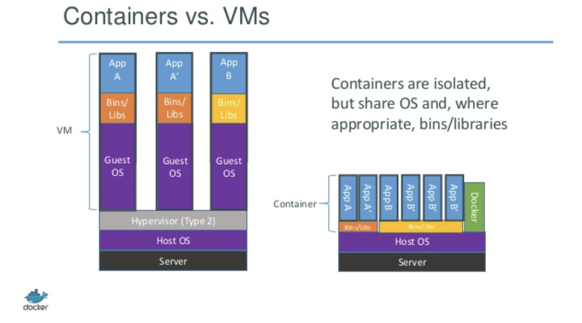
Containers vs Virtual machines
VMs are provisioned with hypervisors
Applications run inside a virtual machine on top of the guest OS
Containers
Containers run directly as processes on the host OS
No middle layers
Very light footprint → pack a higher number of containers than VMs on the same physical machine

Slide 27
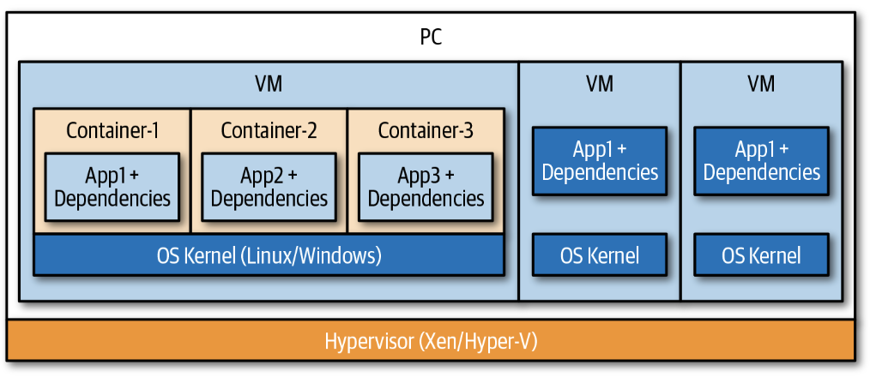
Containers vs virtual machines

Slide 28
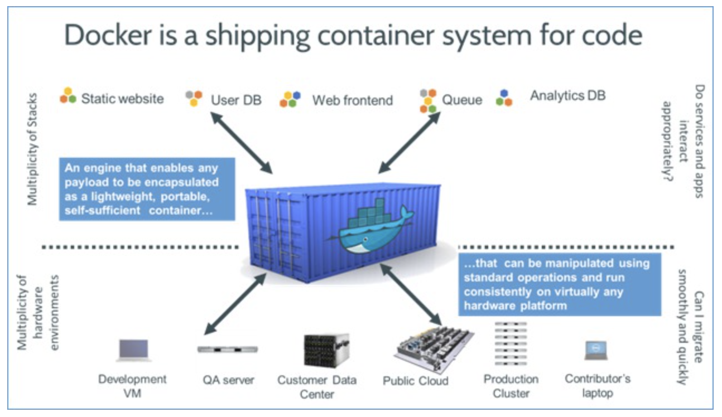
Containers
With containers, the application and all its dependencies can be bundled into one unit.
We can deploy the unit to different platforms and it will run identically on each of them.

Slide 29
Images
The blueprint for a container

Slide 30
Images and Containers
The box of our application code and its dependencies and libraries is called an image
A running instance of this box is called a container.
The image must contain everything needed to run an application: dependencies, configurations, scripts, binaries, etc.
The image also contains other configurations for the container, including environment variables, a default command to run, and other metadata.
A running container uses an isolated filesystem.

Slide 31
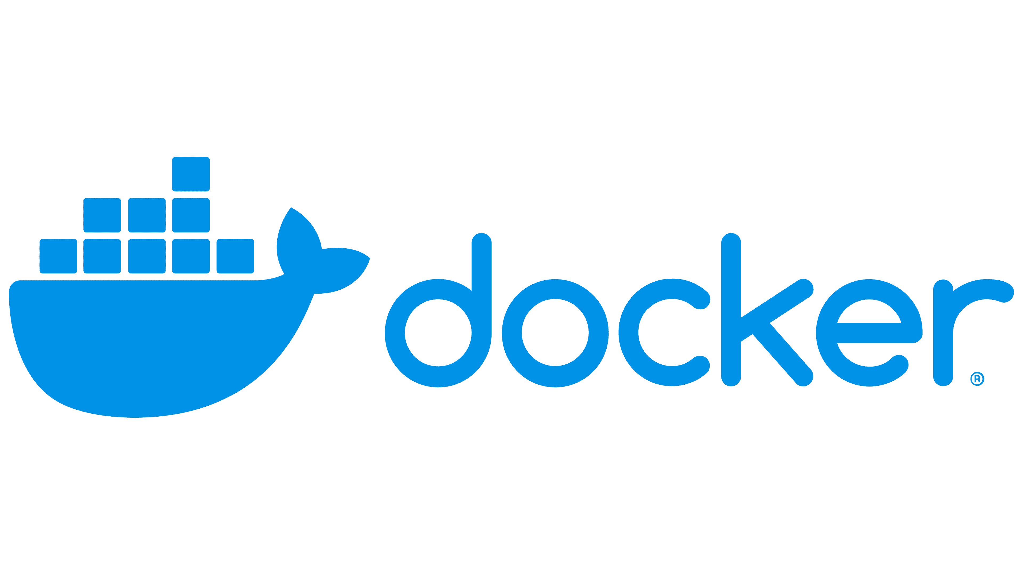
Docker
Docker has become the de facto container tool (“container” is often synonymous with “Docker container”)
A platform designed to help developers build, share, and run container applications
Docker alternatives: Podman (Red Hat)

Slide 32
Review
Container: a running process with resource and capability constraints managed by a computer’s operating system.
Image: a set of files needed to run containers and its processes. A template on which you can create an unlimited number of containers. Contains the information needed to execute a program within a container.
Repository: A space to store code, configurations, etc.
Images can be stored in repositories. In container world, these are called registries.

Slide 33
Container Registries
Specialized web applications that categorize and store repositories.
Tools that build, run, and manage containers need access to images; access is provided by referencing a registry.
Any environment using containers will need to use one or more registries

Slide 34
Container Registries
When we create our container image we start with a base image.
This image is pulled from a container registry.
Docker Hub
Private registries
Why might we use a private registry?
Development
Registry
image: latest
image: latest
image:v1
Testing/ Staging
image:v2
image:v2
Production
image:v2

Slide 35
Micro Operating systems for containers
Current global trend is to run applications in containers.
Want to eliminate packages and services of the host OS which are not essential for running containers
This has led to specialized minimal OS to run just containers
Micro OS as host OS
Can also be used as container OS as they allow for fast container startups and provide lightweight container environment

Slide 36
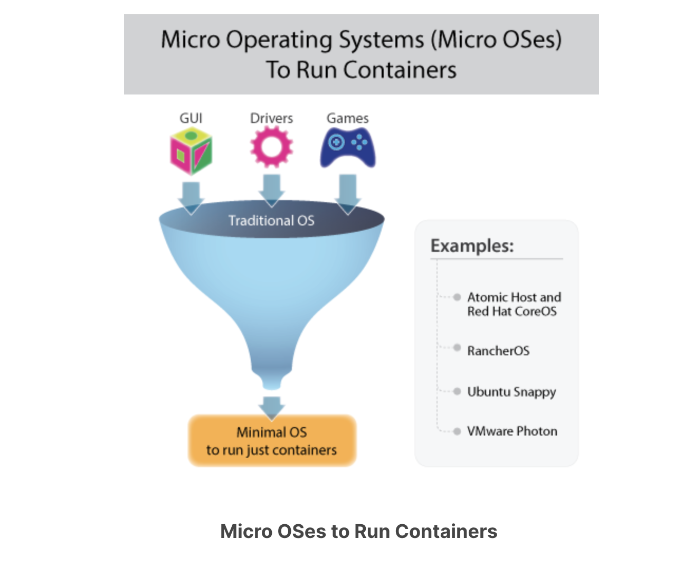
Micro Operating systems for containers
Alpine Linux
Busybox
Fedora CoreOS
Flatcar Container Linux
openSUSE MicroOS
RancherOS
Rancher k3OS
Ubuntu Core
VMware Photon OS

Slide 37
Benefits of Using containers
Light footprint
Can be deployed within milliseconds
Flexible (can run on any computer, infrastructure, cloud environment)
Scaled up or down easily
Rich ecosystem
Use less memory and CPU than VMs running similar workloads
Increase productivity with reduced overhead
Portable and consistent

Slide 38
How to containerize your application
Dockerfiles

Slide 39
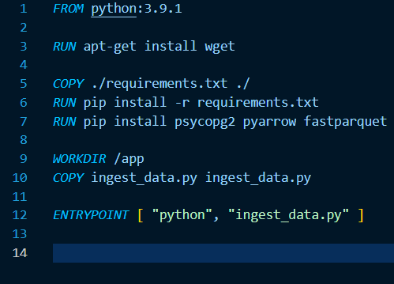
DockerFiles
Used to automate the creation of a Docker container image
A recipe for how to build the container image
Every Dockerfile builds on other container images.
FROM python:3.11-slim
Available from Dockerhub

Slide 40
Dockerfile Syntax
Instruction | Description
FROM <image> | Defines a base for your image
RUN <command> | Executes any commands in a new layer on top of the current image and commits the result. RUN also has a shell form for running commands
WORKDIR <directory> | Sets the working directory for any RUN, CMD, ENTRYPOINT, COPY, and ADD instructions that follow it in the Dockerfile
COPY <src> <dest> | Copies new files or directories from <src> and adds them to the filesystem of the container at the path <dest>
CMD <command> | Lets you define the default program that is run once you start the container based on this image. Each Dockerfile only has one CMD, and only the last CMD instance is respected when multiple exist.

Slide 41
Elements of a Dockerfile
FROM python:3.11-slim #The image available from Dockerhub
WORKDIR /app #The working directory where your app code lives
COPY requirements.txt /app/ #Copy requirements into app
RUN pip install requirements.txt #Install dependencies
COPY . . #Copy all the app files into the image
CMD [“python3”, “-m”, “flask”, “run”, “—host=0.0.0.0”, “—port”,”5000”]. #start server

Slide 42
Containers- Use Cases

Slide 43
Containerization Benefits
Application Isolation
Portability
Simplified deployment (hybrid, multi-cloud)
Consistency
Resource efficiency
Horizontal Scaling
Rolling Updates

Slide 44
When Do we Use containers?
“Lift and shift” existing applications into modern cloud architectures
Refactor existing applications for containers
Develop new container-native applications
Provide better support for microservice architectures
Provide easier deployment of repetitive jobs and tasks

Slide 45
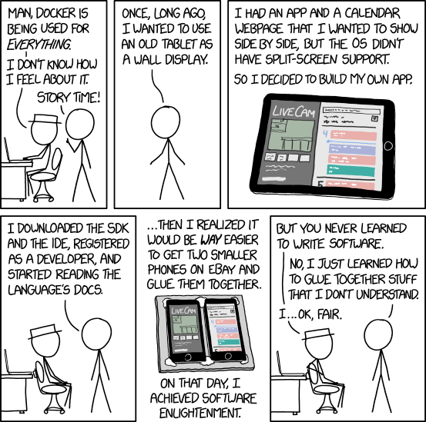
Relevant XKCD
We use containers everywhere for everything.
This is both super helpful for getting products to market faster and also abstracts away a lot of basic OS stuff that… maybe we’re supposed to know?

Slide 46
Land Acknowledgement Statement
We respectfully acknowledge the University of Arizona is on the land and territories of Indigenous peoples. Today, Arizona is home to 22 federally-recognized tribes, with Tucson being home to the O’odham and the Yacqui. Committed to diversity and inclusion, the University strives to build sustainable relationships with sovereign Native Nations and Indigenous communities through education offerings, partnerships, and community service.

